Slide 1
APE Client-Server Tester
Kyle Phillips
Stephen Walmsley

Slide 2
Background and Topic
Client-Server based tester
Client – Text editor for Java Code
Server – Attempts to compile Client sent code and test against output keys

Slide 3
Goals and Details
GUI based client that allows file editing and sending a loaded file to server
Server that receives client code from multiple clients, attempt to compile client code, and respond to client whether or not code ran correctly against output keys for the compiled class.
Thread pool based server to allow multiple client connections dynamically.

Slide 4
Client Architecture
Client window class allows user to open files, save files, and submit a loaded file to the server for testing. It also allows text editing of an opened file.
Client class is called from client window class, and sets up all the connections to the server after being passed information from the client window class.

Slide 5
Server Architecture
Server starts up and creates a static thread pool to manage client-submitted APE jobs.
Source converter class looks for the passed in file’s class name.
Once a class name has been obtained, it waits until it is allowed to compile.
If compiling was successful, it runs and produces output, which is piped to a text file.
This output is compared to a predefined key that matches the passed in class name.

Slide 6
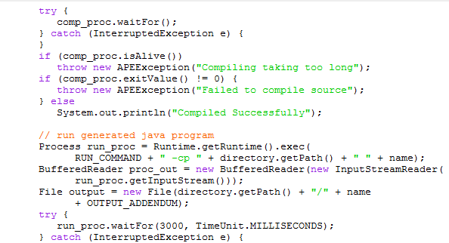
Solved Issues
Dynamic thread pool interrupted threads during compiling and run time.
To fix this, changed to a static thread pool, which doesn’t interrupt threads to resize the thread pool.

Slide 7
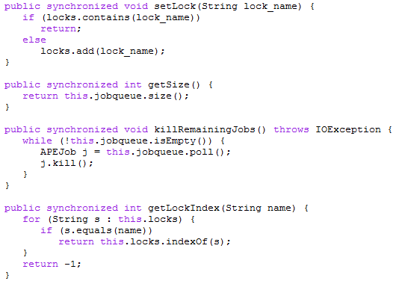
Solved Issue
Class collisions: Two clients trying to compile the same class at the same time.
Solution: Directory structure and dynamic lock array list which forces one thread to wait if another thread is compiling and running the same class.

Slide 8
Shortcomings
Some minor issues with client GUI.
Sending an empty string (nothing in text box) makes client wait forever for response from server.
Server tells client if code compiled and if code ran successfully against an output key, but it does not give specific feedback on any other issues, such as a method that does not work correctly.

Slide 9
Extending
Server:
Allowing server to pass in command line arguments when running to allow for better testing.
Add another level of directory structure based on student id, to make passed in client information more unique server-side. Also would free up lock fixes we had to implement.
Client:
Allow user to pass in a student id (see above).
Bug fixes.
Allow user to view/edit specific methods relevant to APE questions rather than edit the entire source code.

Slide 10
End

